Slide 1

DJANGO Project
Book Finder
GitHub
Site

Slide 2

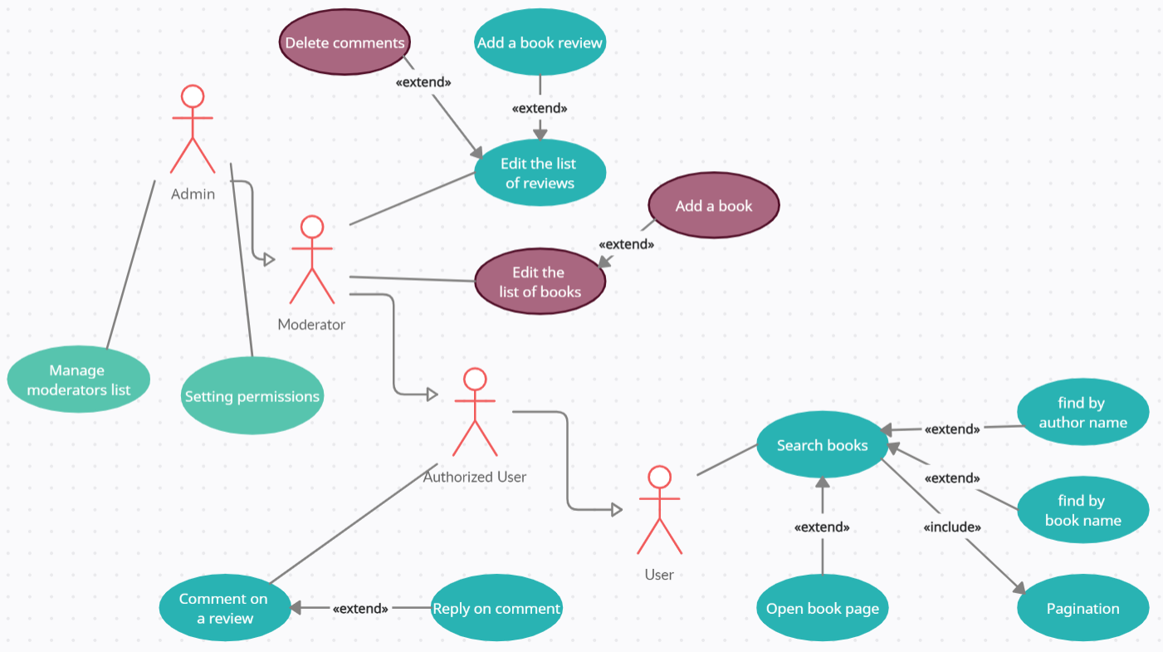
UseCase diagram

Slide 3
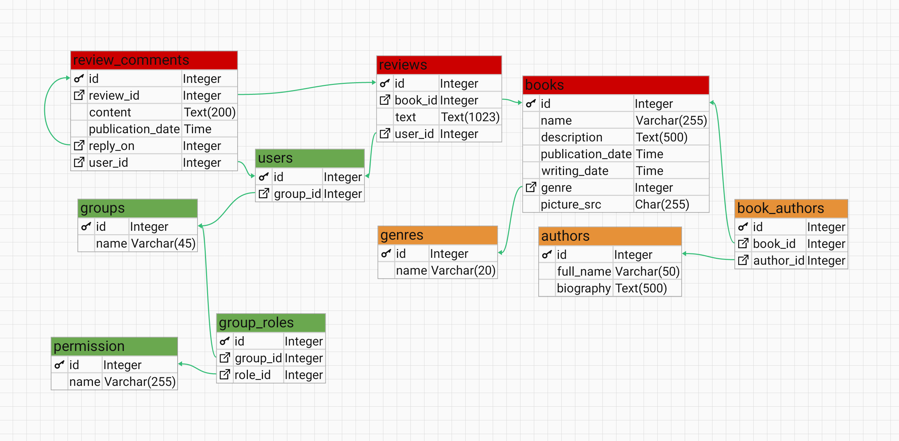
Database IDEF1X model

Slide 4
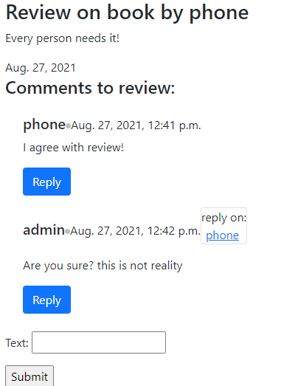
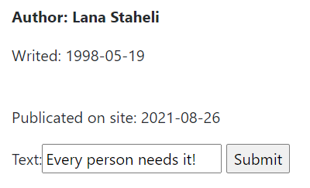
Form from book page:
Creating reviews and comments

Slide 5
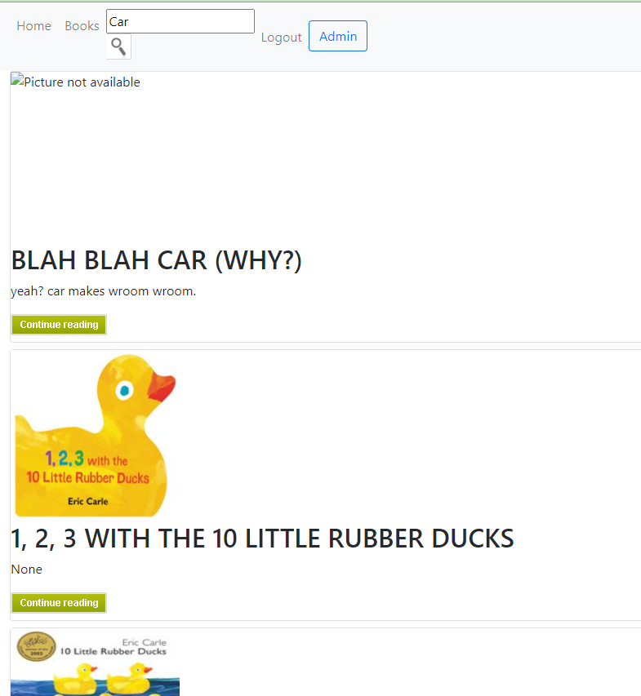

Search by name and author

Slide 6
Thank you
for the attention!
Now - Demo

